Slide 1
Bike Sharing Demand Analysis: Time, Weather, User type
By: Kondepudi Gayattre
Digicrome Academy
Data Science with AI Course

Slide 2
Agenda
01 | Objective
02 | Data Preparation
03 | Overall Usage
04 | Hourly Demand
05 | Weekly Pattern
06 | Monthly Trend
07 | User Type Analysis
08 | Weather Impact
09 | Correlation Analysis
10 | Key Insights

Slide 3
Objective of Analysis
The objective of this analysis is to understand bike rental demand patterns
Identify the key factors influencing usage.
By analyzing user behavior, time based trends & weather conditions, we aim to uncover actionable insights that can help improve demand forecasting & operational efficiency.

Slide 4
Preparing Data for Meaningful Analysis
When we started this analysis, the main objective was to understand what really drives bike rental demand
Because at a surface level, the numbers fluctuate, but the reasons behind it aren’t obvious.
So instead of looking at everything at once, we approached it step by step
Starting with the overall demand, & then breaking it down into time, behavior, & external conditions.
Raw Data
Created Data Table
Handled Missing Values
Removed Duplicates & Inconsistent Data
Feature Engineering
(Day,Month,Weather)
Structured Data for Analysis

Slide 5



A Quick Look at Overall Usage
The platform recorded a total of 58,304 rentals, with a significant majority coming from registered users.
This clearly indicates that the service is heavily driven by a loyal & recurring customer base rather than occasional users.

Slide 6
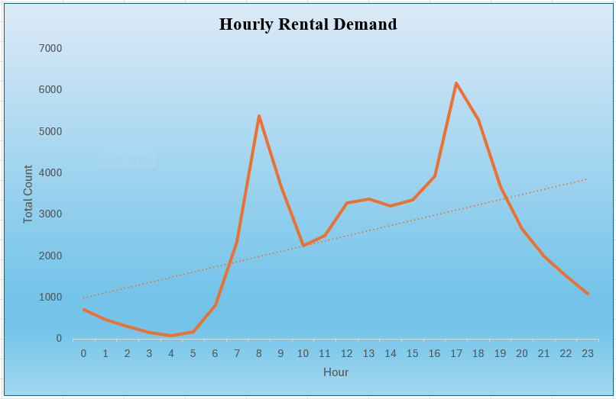
When is the demand at Peak?
Analyzing the hourly rental pattern reveals a clear trend.
Demand peaks sharply at around 8AM & again at 5-6PM.
This strongly suggests that the service is primarily used for daily commuting.
Additionally, rental activity drops significantly during late night hours, reinforcing the idea that usage is aligned with working schedules.

Slide 7
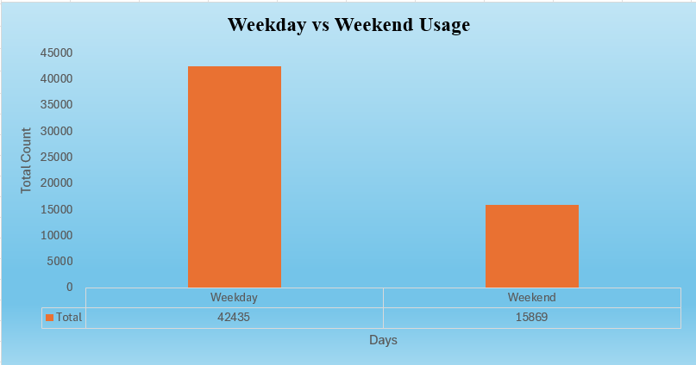
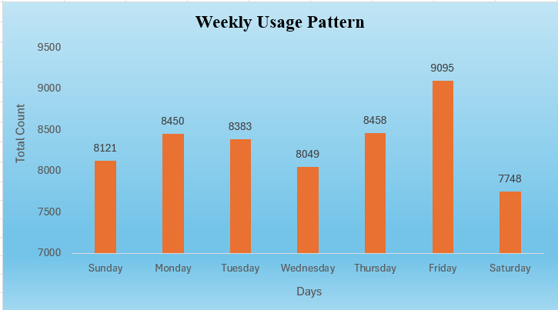
Weekday Usage Dominates Rentals
Now, if usage is driven by commuting, it should also reflect in weekday patterns
Looking at usage across the weak, weekday demand is significantly higher than weekends.
So this reinforces the idea that this is a utility driven service rather than purely leisure based.
Friday shows peak usage
Slight drop observed on weekends - indicating more recreational usage during that time.

Slide 8
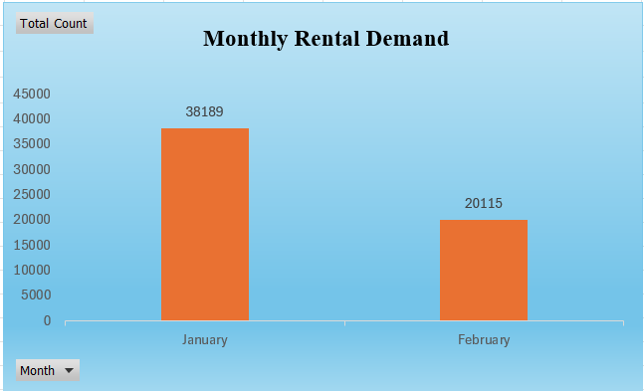
Demand Shows Monthly Variation
January records higher rentals
February shows noticeable decline
This decline suggests possible seasonal or extreme impact.

Slide 9
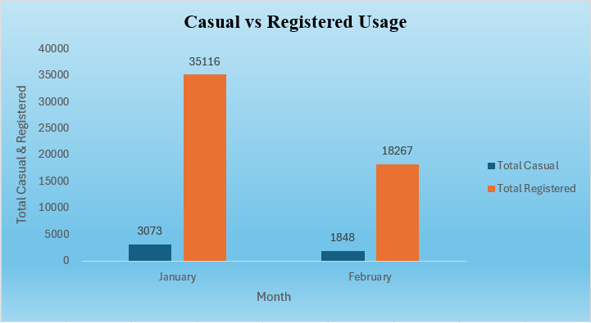
Registered Users Drive Majority Demand
To go one level deeper, we looked at who is contributing to this demand - and again, registered users dominate.
Registered users contribute ~90% of rentals.
Causal users form a smaller portion.
Indicates strong recurring & loyal user base.

Slide 10
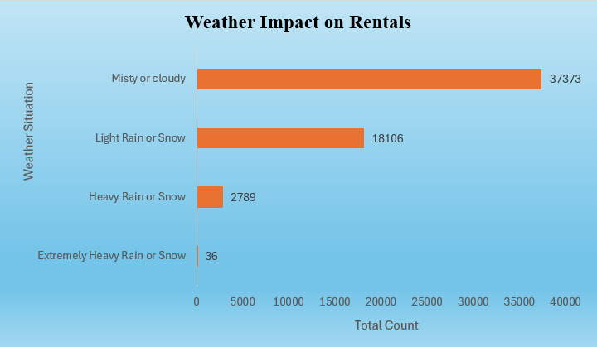
Weather Conditions Influence Rental Demand
At this point, we understood the behavioral side – but demand is not driven by behavior alone.
External conditions also play a major role – especially weather.
Highest - Mist/Cloudy weather.
Moderate drop - Light Rain/Snow.
Very low demand - Heavy/Extreme weather conditions.
This highlights the sensitivity of users to unfavorable weather as bike usage is directly affected by comfort & safety.

Slide 11



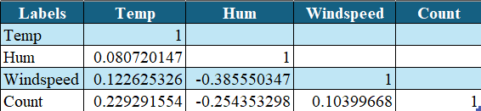
Key Weather Factors Affecting Demand
We then extended this analysis further into environmental factors.
Temperature shows a positive relationship – as it increases, rentals increase up to a comfortable range.
But windspeed shows the opposite – higher wind leads to reduced rentals.

Slide 12
Key Insights
It is driven by a combination of routine behavior, user type & environmental conditions.
Demand driven by daily commute patterns
Weekdays dominate usage behavior
Weather significantly impact rentals
Registered users ensure consistent demand

Slide 13
From Data to Decisions
In conclusion, bike rental demand is primarily driven by commuting behavior, with strong dependence on time of day & weekdays.
Weather conditions, especially humidity & extreme situations significantly impact usage, while a loyal user base drives stability
These insights can help in better demand planning, pricing strategies & improving overall service efficiency.
From a business perspective, this has direct implications.
We can ensure higher availability during peak commuting hours, plan operations based on weather forecasts & create strategies to increase casual usage where demand is lower.

Slide 14
Thank You

